Slide 1

ICT 581 HTML5 and CSS3 with jQuery
Continuing Education
Day 5: React.js JSX, Elements, Components and Properties
Mostafa Mohamed, PhD, P.Eng.
Adjunct Professor,
Electrical and Software Engineering Department
Mostafa.Mohamed@ucalgary.ca
@ 2022

Slide 2
Previous Class
Introduction to React.js
Development environment
React elements, syntax and first React scripts

Slide 3
Agenda
React.js JSX
Elements
Components and Properties
Reading:
https://reactjs.org/docs/introducing-jsx.html
https://reactjs.org/docs/rendering-elements.html
https://reactjs.org/docs/components-and-props.html

Slide 4
React.js JSX

Slide 5
React.js JSX
Basic familiarity with HTML & CSS
Basic knowledge of JavaScript
Basic understanding of the DOM

Slide 6
Why JSX?
Mixing HTML with JS in a more powerful way
const name = 'Mostafa';
const element = <h1>Hello, {name}</h1>;
const element = (
<div>
<h1>Hello!</h1>
<h2>Good to see you here.</h2>
</div>
);

Slide 7
JSX and Babel
Javascript compiler https://babeljs.io/
Nice tutorial on Styles with JSX: https://techstacker.com/how-to-inline-style-jsx-react-css/

Slide 8
React Elements

Slide 9
React Elements
Light weight DOM elements created and maintained by React DOM
This is what user sees
They are not immutable: to change anything in the elements, you replace the element with a new one
Elements are the base for React components (components are made of elements)

Slide 10
Example element
Any JSX part is an element
E.g.: const element = <h1>Hello, ICT581</h1>;
To render it in a page, use ReactDOM.createRoot(..).render(element)
const root = ReactDOM.createRoot(
document.getElementById('root')
);
root.render(element);

Slide 11
Changing the Element
Elements are immutable (can’t change any part of it)
The only way is to change the whole element
React compares the new element with the current one, and only update the part of it that need changing, which makes it fast to response

Slide 12
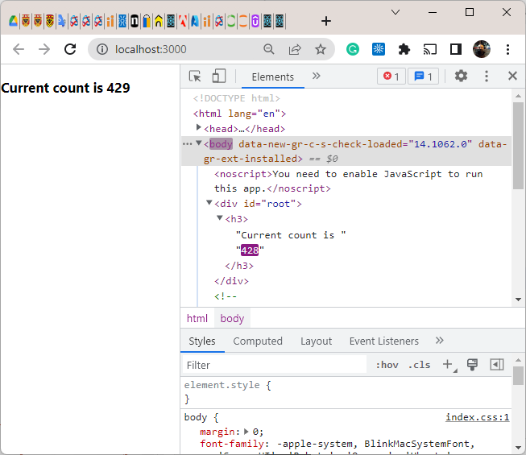
Updating an Element
const root = ReactDOM.createRoot(document.getElementById('root'));
var t = 0;
setInterval(show, 100);
function show() {
const myElement = <h3>Current count is {t}</h3>;
root.render(myElement);
t++;
}
See: day5-demo2-elements.html

Slide 13
Components & Properties

Slide 14
React Components
Components are small independent units of code that with generally one concern
Components take input values, called properties and return the React element to be rendered
Components are similar to JS function, and they can be made with functions as will be presented
Components allow you to divide your UI into small reusable parts
We can create component either as a function or as a React Class
Components can have other components is their output

Slide 15
Properties
React sends only one argument named “props” (properties) to the component
props: is of type Object and include all parameters for that Component
Inside the Component, you access the separate property by using props.<property name>
Properties should be Read only, never change a property value. This is called pure component

Slide 16
Function Component
The easiest way to create a component by creating a JS function that takes only one argument (props) and return JSX element to be rendered
Component name must start with a CAPITAL letter
See: day5-demo3-components.html
const root = ReactDOM.createRoot(document.getElementById('root'));
function MainComp(props) {
const myElement = (
<div>
<h2>Welcome {props.name}</h2>
<h3>This is a simple Function Component</h3>
<p>{props.email}</p>
</div>
);
return myElement;
}
root.render(<MainComp name='Mostafa' email='mostafa@server.com' />);

Slide 17
Activity

Slide 18
Water bucket challenge game
Using 2 buckets of sizes 3 and 5 liters, fill-up a third bucket with exactly 4 Liters.
The third bucket is larger than 4 L but unknown size
5L
>4L
3L

Slide 19
Task
Add the game title and description on the page
Add legend to each bucket to show its size and the current water level in the bucket

Slide 21
Summary
React.js JSX
Elements
Components
Properties

Slide 22
Thank you for attending today!!!
Mostafa Mohamed, PhD, P.Eng.
Mostafa.Mohamed@ucalgary.ca
WhatsApp: 403-966-8112

